Slide 1

LOW COST HOME SURVEILLANCE AUTOMATION
BOOBALARAGAVAN (1831009)
DHARANI PRASAD (1831013)
KALAI PRIYA (1831027)
RESHMA (1831040)

Slide 2
PROBLEM STATEMENT
Set up and monitor automated home surveillance with NodeMCU and OV7670 camera to optimize setup cost
Providing live video feed of the surveillance footage through a mobile application for remote and easy access, integrated with Machine Learning model for face recognition

Slide 3
PROGRESS OF THE PROJECT
Face Recognition
Face detection using OpenCV and python
Camera Module
OV7670 camera module is connected with Arduino

Slide 4
HARDWARE PROGRESS
Modules are dismantled from unused phones
Camera Module
Microphone
Speakers
As the pin configuration does not apply for interfacing the microcontrollers, so the idea was replaced to use OV7670 Camera Module with Arduino UNO and ESP8266
OV7670 Camera module was interfaced with the Arduino UNO board and images were rendered through the module

Slide 5
SOFTWARE PROGRESS
Face detection using python and OpenCV have been implemented
Faces in the provided images were detected successfully

Slide 6
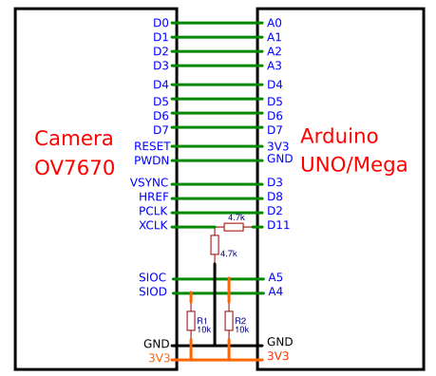
PIN DIAGRAM FOR CONNECTING OV7670 CAMERA MODULE WITH ARDUINO UNO

Slide 7
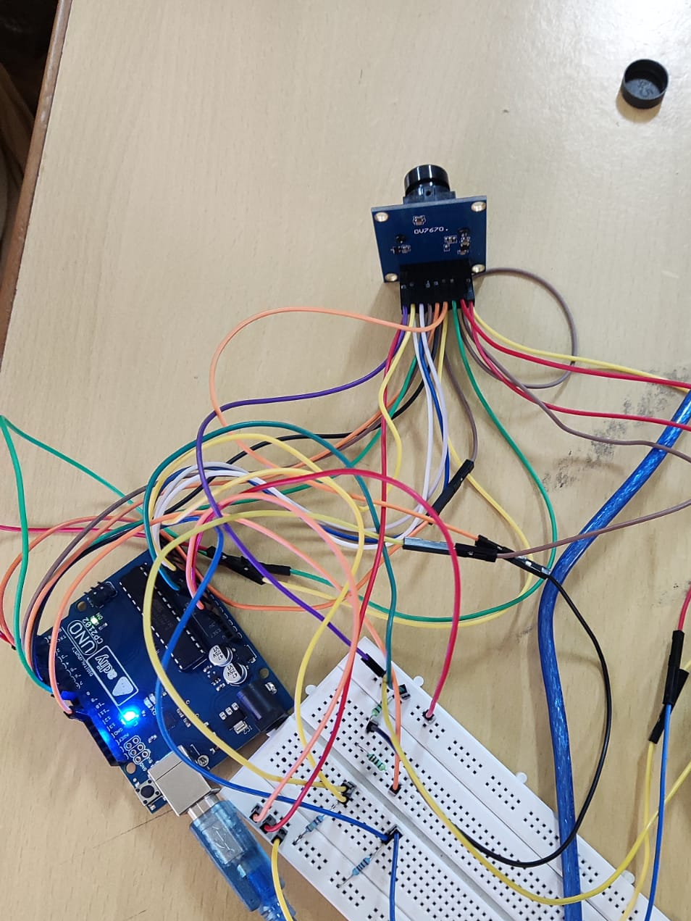
ARDUIN0 UNO AND OV7670 CAMERA MODULE CONNECTIVITY

Slide 8
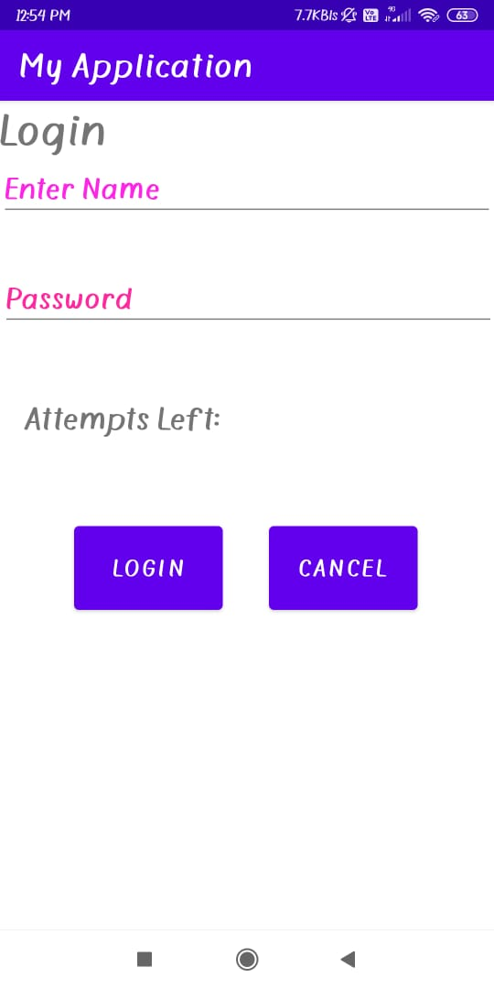
LOGIN MODULE - APPLICATION

Slide 9
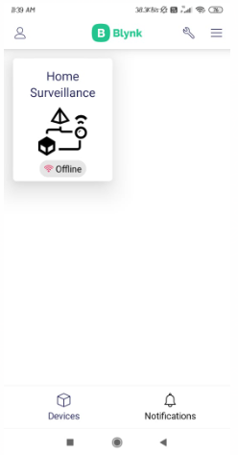
OUTPUT - BLYNK MOBILE APPLICATION

Slide 10
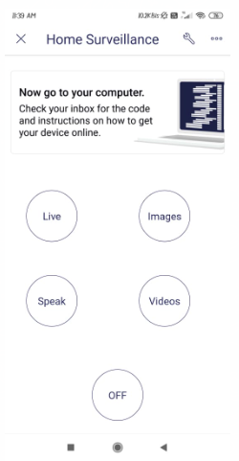
OUTPUT - UI DESIGN FOR CONTROLLING THE SYSTEM

Slide 11
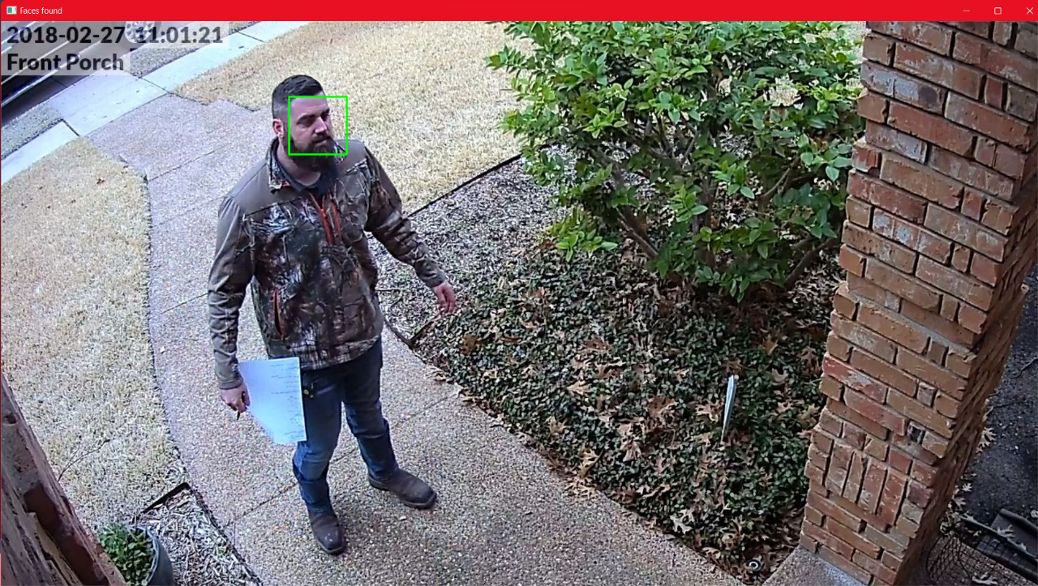
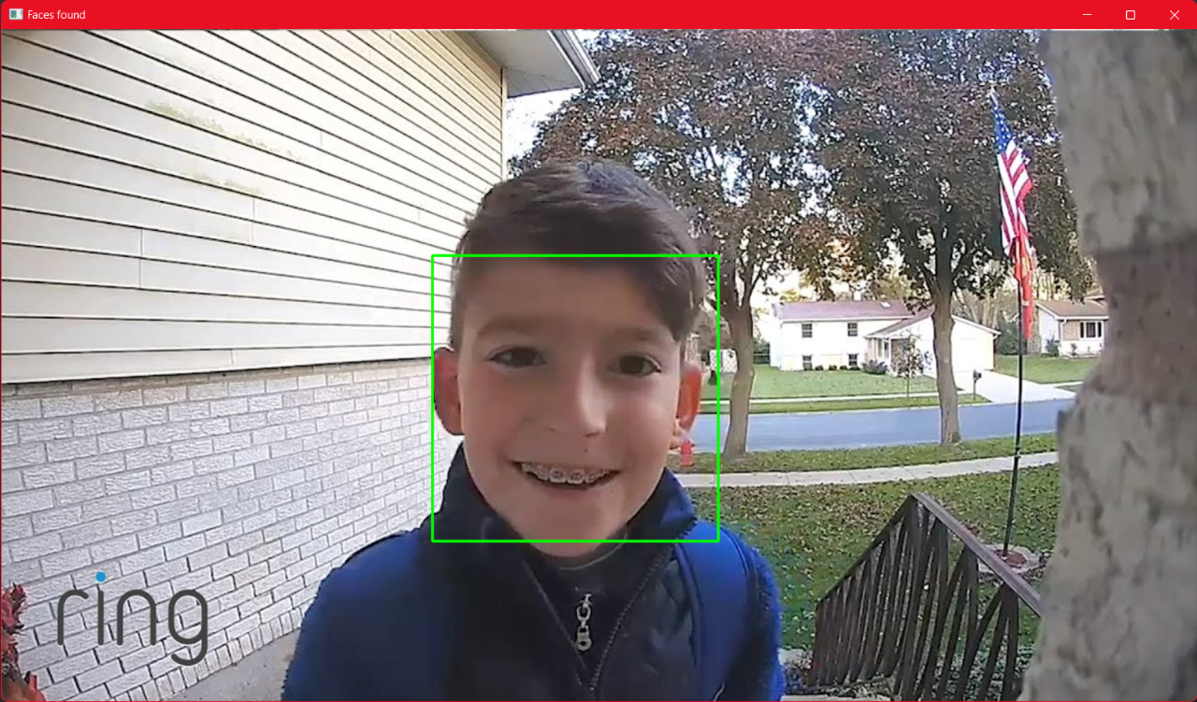
OUTPUT - FACE DETECTION

Slide 12
REFERENCES
Interfacing OV7670 with Arduino - How to Use OV7670 Camera Module with Arduino​ Uno (circuitdigest.com)
Arduino and ESP8266 - How to Communicate with ESP8266 via Arduino UNO - Arduino Project Hub
Usage of Blynk Mobile Application - Control Your IoT Cloud Kit via Blynk | Arduino Documentation | Arduino Documentation

